Slide 2
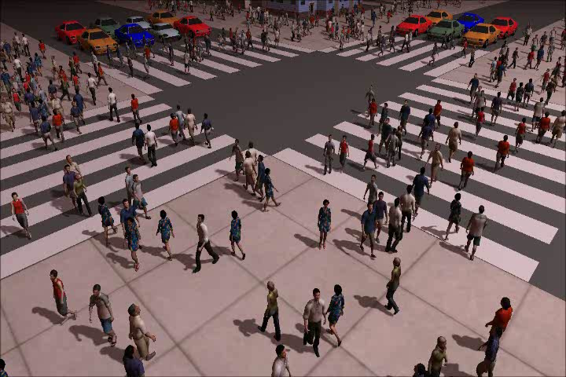
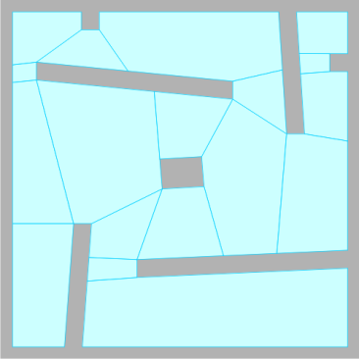

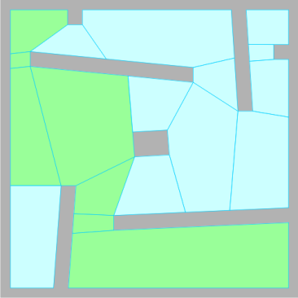



Introduction
Path planning in virtual (game) environments
  Global planning: find a main route
  Local planning: variety, collision avoidance
  Navigation mesh = subdivision into walkable cells
  Route = sequence of cells + flexibility
Many characters:
crowd simulation

Slide 3
Outline
LEVEL 1

Slide 4
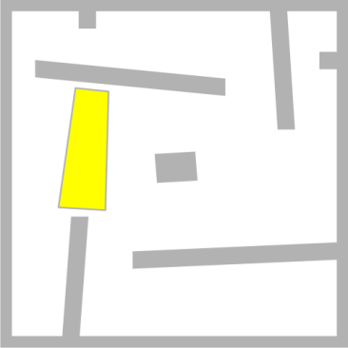
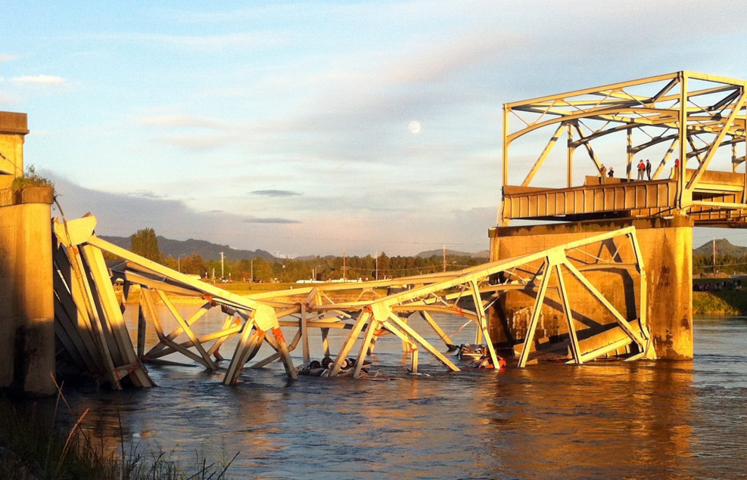
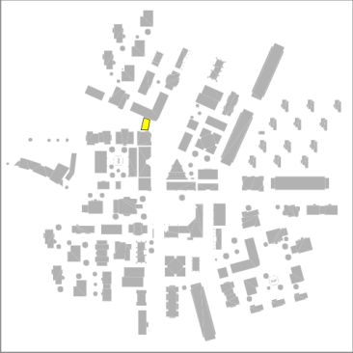
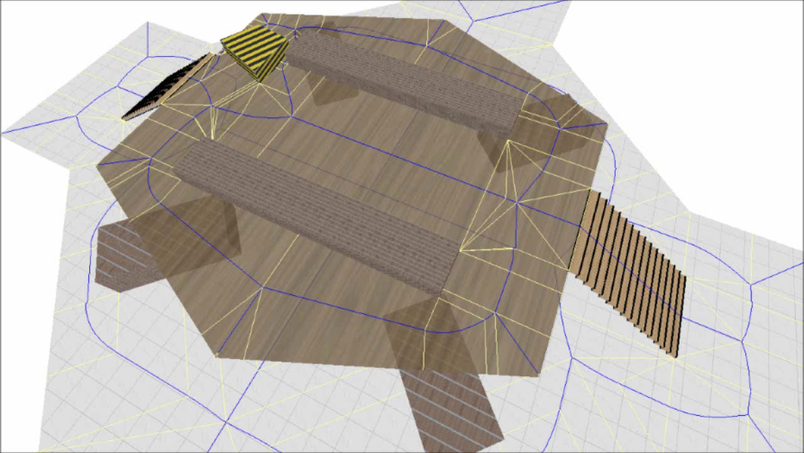
Problem / Overview
Dynamic environments
  Obstacles appear, disappear, or move
  Local collision avoidance can’t (always) handle it
  This is global: update the navigation mesh...
  ...but don’t recompute it from scratch
We introduce the dynamic ECM
  Explicit Corridor Map: useful navigation mesh
  Local insertions and deletions
  Based on Voronoi diagrams
Results
  Real-time updates
  Dynamic path planning

Slide 5
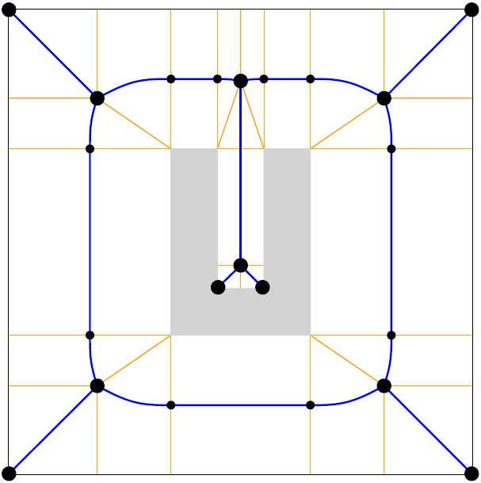
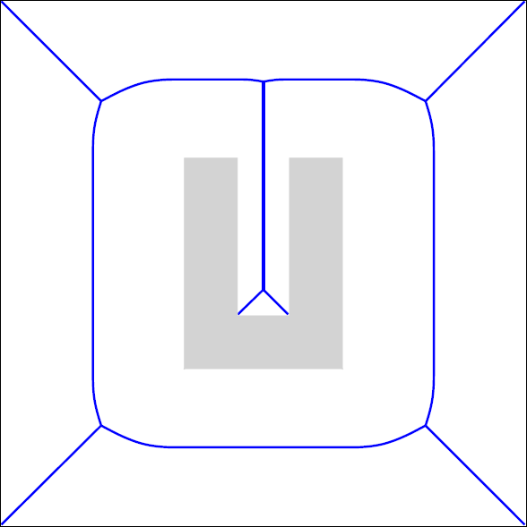
Explicit Corridor Map (ECM)
Medial axis
  The set of all points with at
  least two closest obstacle points
  Pruned Voronoi diagram
  Changes shape at normals
ECM
  MA + closest obstacles at
  event points
  O(n log n) construction
  O(n) storage

Slide 6
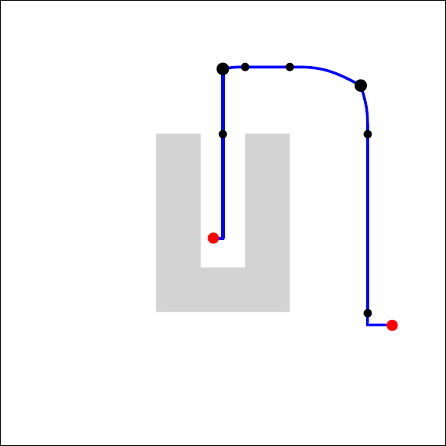
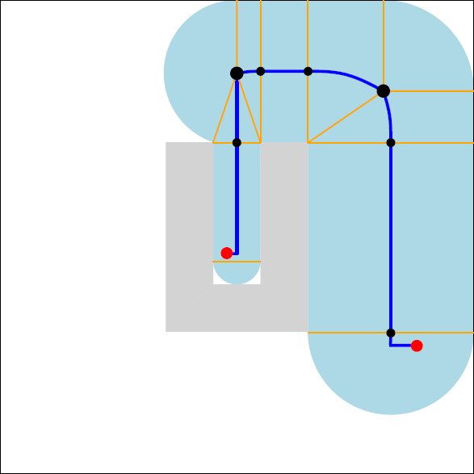
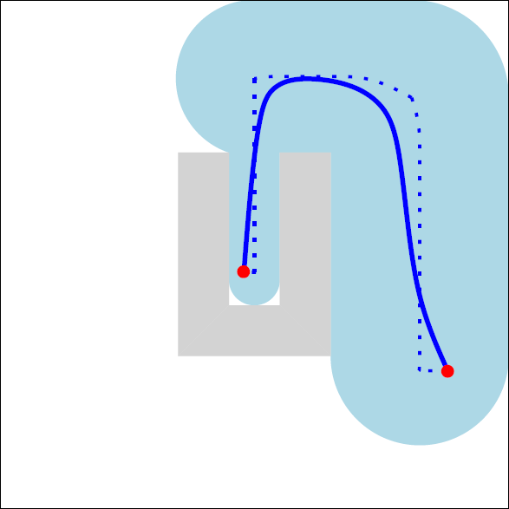
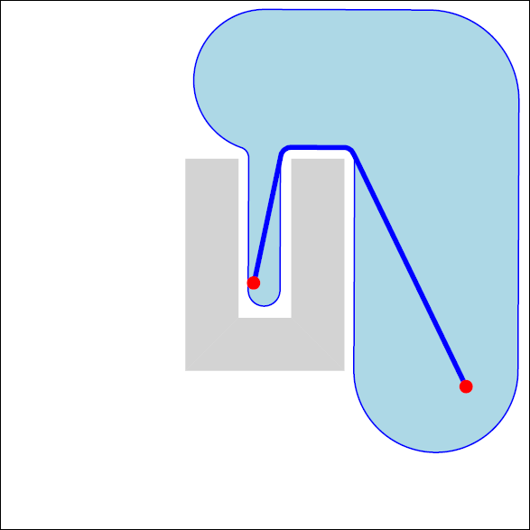

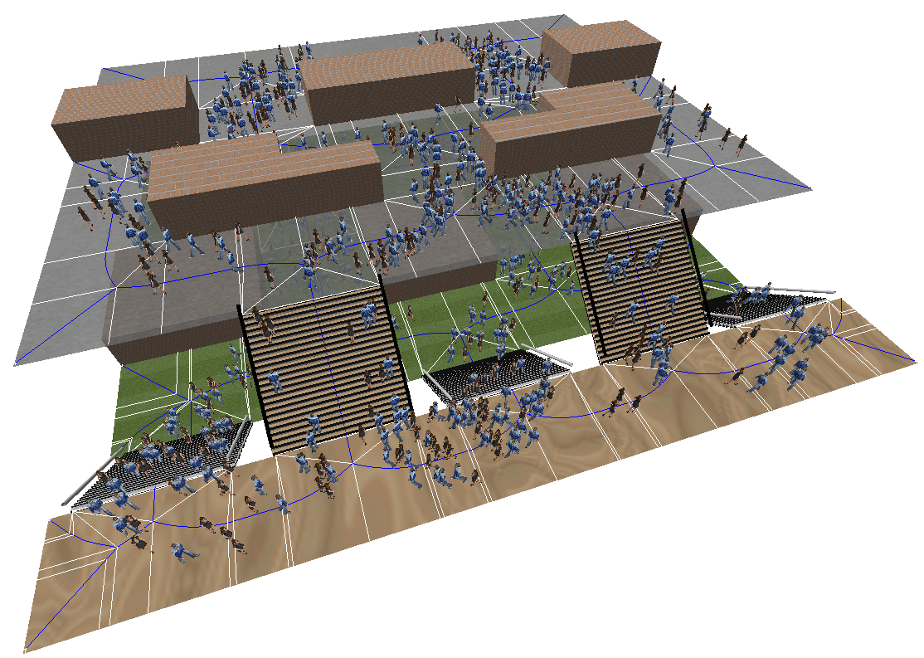
Explicit Corridor Map (ECM)
A flexible navigation mesh
  Clearance information
  Supports all character sizes
  Global planning on the MA
  Result: path + corridor
  Following indicative routes
  Short paths with clearance
  Collision avoidance
  Multi-layered environments
  Dynamic updates

Slide 7
Insert
LEVEL 2

Slide 8

Assumptions
Input = Medial axis
  ECM annotations can be added later
The inserted obstacle...
  ...is convex
  ...does not intersect other obstacles
  This can be overcome
Explanation in 3 steps
  Point among points
  Point among polygons
  Polygon among polygons

Slide 9
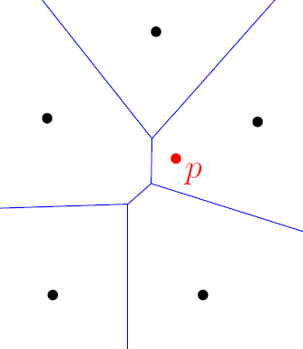
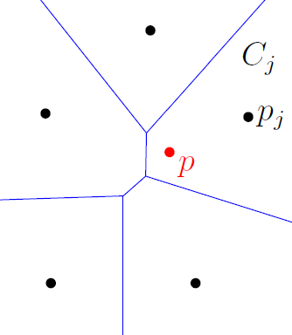
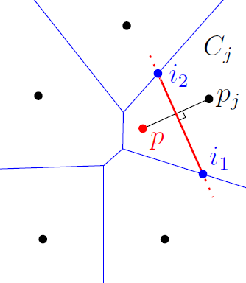
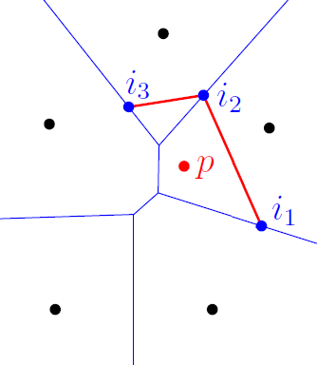
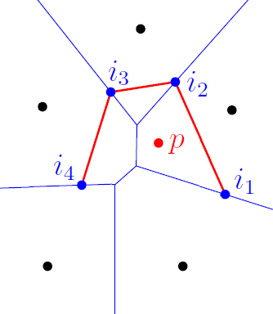
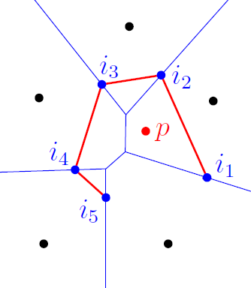
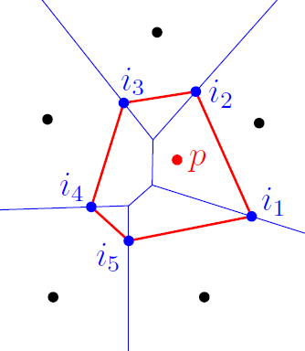
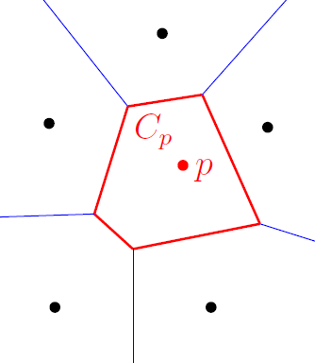
Insert: point among points
Voronoi diagram of points
  Let C_{i} be the Voronoi cell of a point p_{i}
  Let p be the point to add
Algorithm (Green/Sibson, ‘78)
  Find the cell C_{j} in which p lies
  Compute the bisector of p and p_{j}
  Find the intersections of bisector and C_{j}
  Compute new neighbor + bisector
  Iterate until the new cell is finished
  Remove the old edges
Complexity: O(k + log n)
  n = number of points
  k = complexity of the new cell

Slide 10
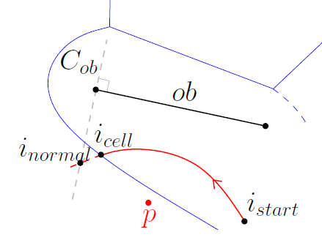
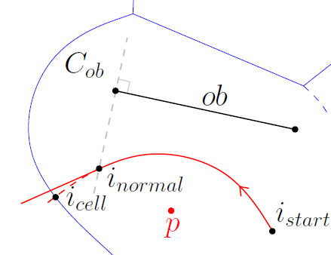
Insert: point among polygons
What if the other obstacles are polygons?
  Edges are chains of line/parabola segments
  An event occurs when the edge
  intersects an obstacle normal
Adapted insertion algorithm
  In each iteration, choose the first of two intersections

Slide 11
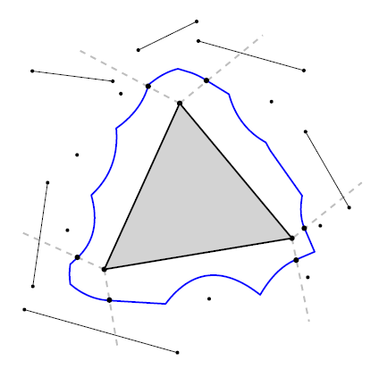
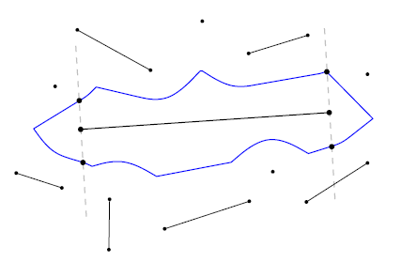
Insert: polygon among polygons
What if the inserted obstacle P is a polygon?
  P can also induce events
Adapted insertion algorithm
  In each iteration, choose the first of three intersections
  a) With the Voronoi cell
  b) With the neighbour’s normal vector
  c) With P’s normal vector

Slide 12
DELETE
LEVEL 3

Slide 13
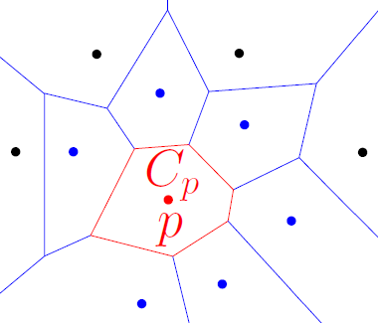
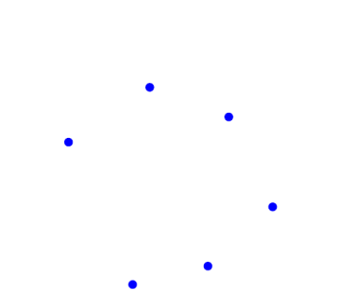
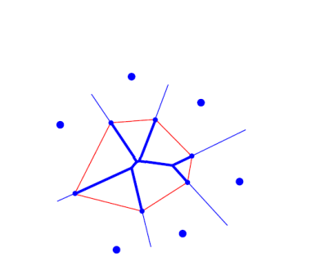
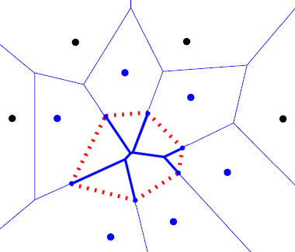
Delete an obstacle
Deleting P: the cell C_{P} needs to be removed
  Its interior must be filled with new edges
  These can only come from P’s neighbours
Deletion algorithm
  Compute N_{P}, the set of neighbors
  Build the medial axis for N_{P}
  Connect the old/new medial axes
  Delete the boundary of C_{P}
Complexity: O(m log m)
  m = number of neighbors for P
Also works for polygons

Slide 14
RESULTS
LEVEL 4

Slide 15
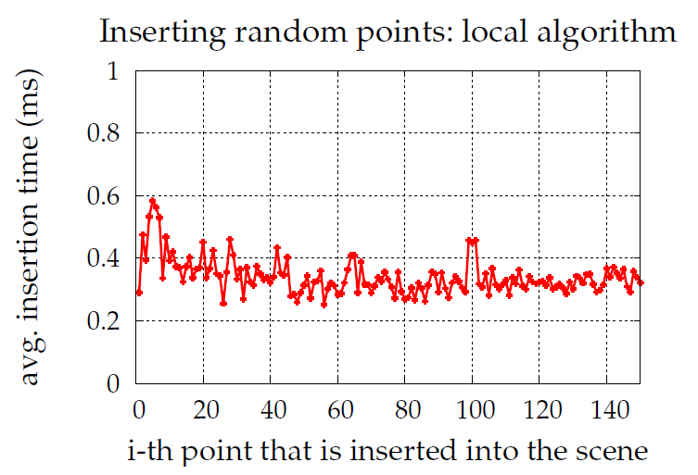
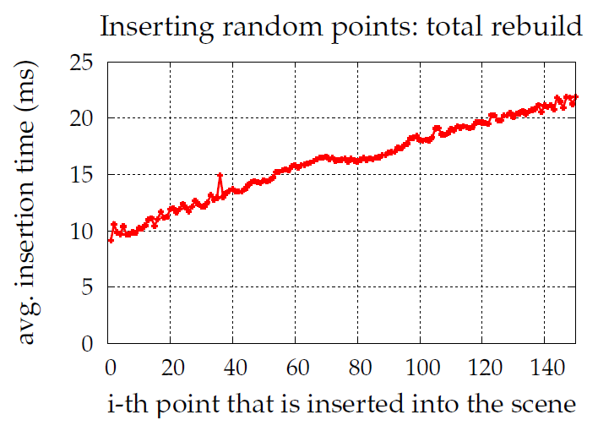
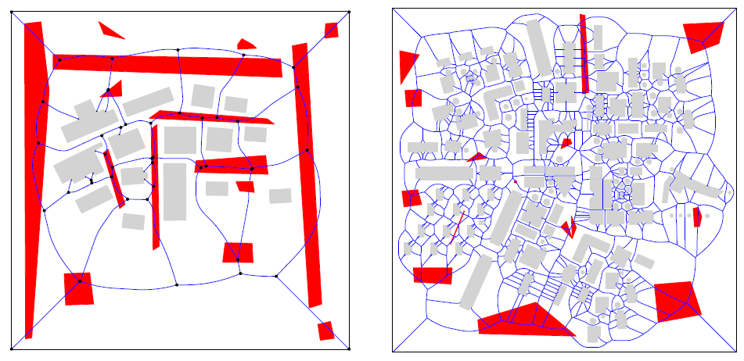
Experimental results
Much faster than complete reconstruction
Running times depend only on the affected area
  In practice, updates will
  be very local
  Real-time performance:
  <5 ms per update
Moving obstacles
  a) Series of deletions and insertions
  b) Re-insertions in a static scene: faster, more robust
  → Demo 1

Slide 16
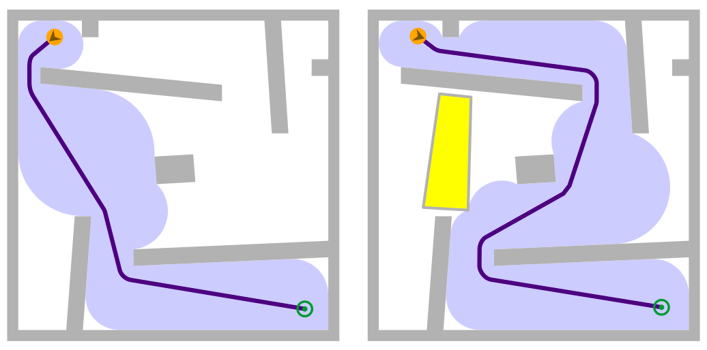
Applied to path planning
Current work: let characters respond to updates
  Recognize that part of the corridor is invalid
  Re-plan the route
  Implemented in our ECM framework → Demo 2
When?
How?

Slide 17
Conclusions
LEVEL 5

Slide 18

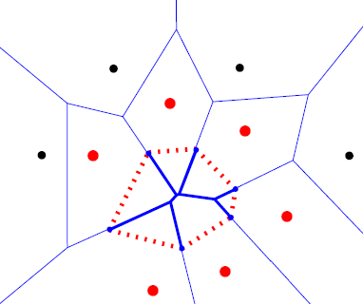
Summary
Algorithms for updating a navigation mesh
  Based on Voronoi diagram techniques
  Insertions of points and polygons
  Deletions based on insertions
Implementation and experiments
  Real-time insertions / deletions
  Movement: real-time insertions into a static scene
Application in path planning
  Let the characters respond: re-planning
  Ongoing research

Slide 19
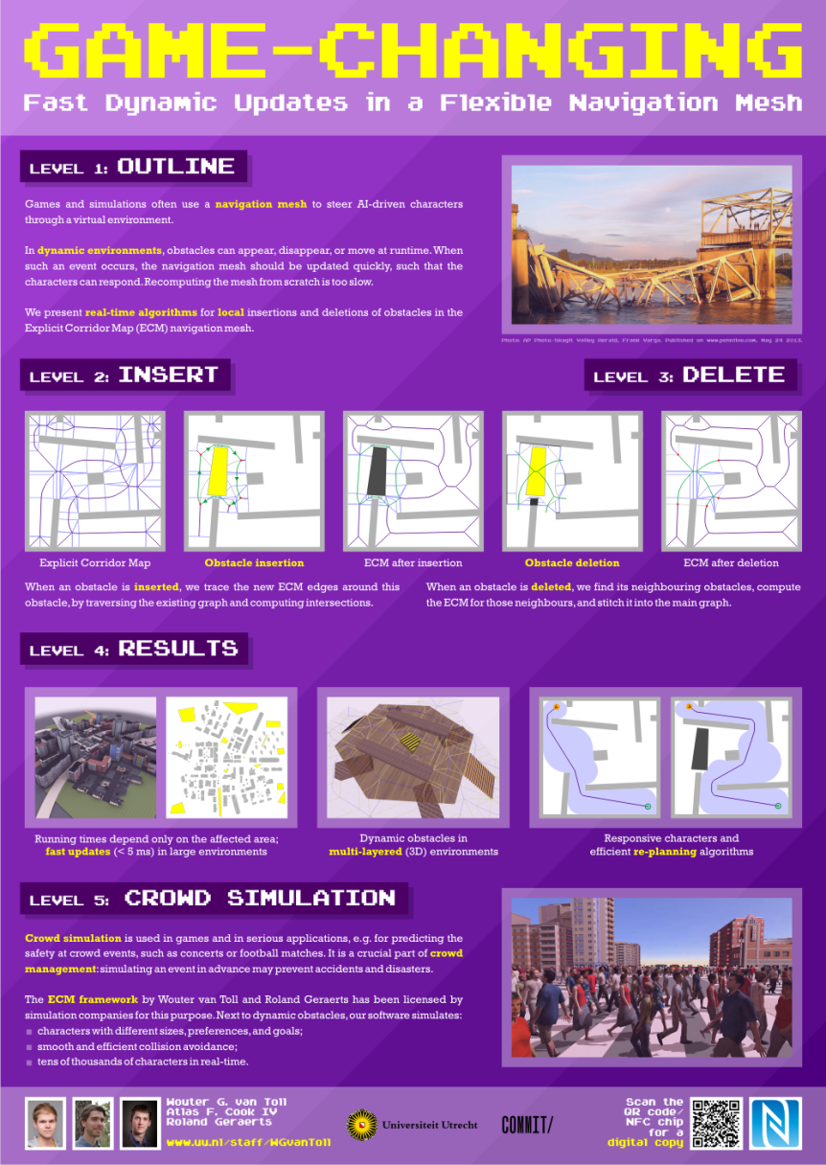
More information

Slide 20

More information
Contact me
  W.G.vanToll@uu.nl
  www.uu.nl/staff/WGvanToll

